Slide 1
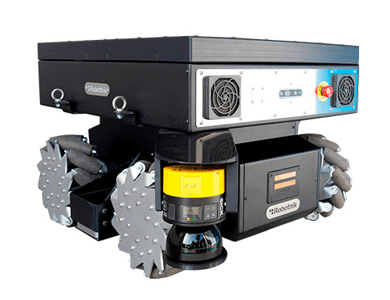

ROBOTIC HARDWARE SYSTEMS UGV : SUMMIT-XL STEEL MOBILE ROBOT
Muhammad Zulhafiz Bin Zulkifli
Muhammad Nazhan Bin Ramli
Muhammad Yusof Bin Mohamed Adam

Slide 2
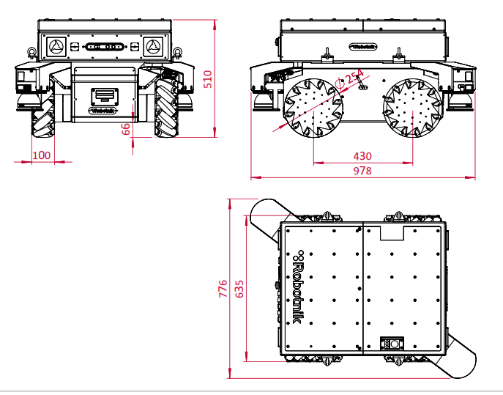
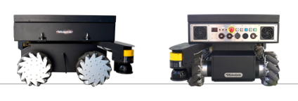
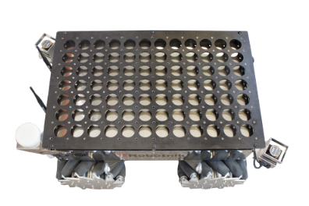
MOBILE ROBOT WITH MECHANICAL STEEL STRUCTURE
Dimensions 978 x 776 x 510 mm
Weight 105 kg
Payload 130 kg / 250 kg
Environment
Indoor
Enclosure class IP52 / IP64
ROBOT BODY DESIGN

Slide 3
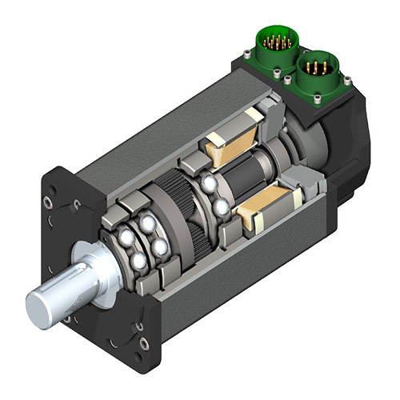
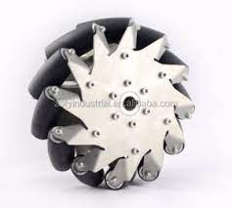
ACTUATORS & LOCOMOTIONS
The mobile platform has omnidirectional kinematics based on 4 high-power mechanum drive wheels. Each wheel integrates a brushless motor with a high precision odometer sensor.
Traction motors: 4 x 500 W brushless servomotors with safety brake

Slide 4
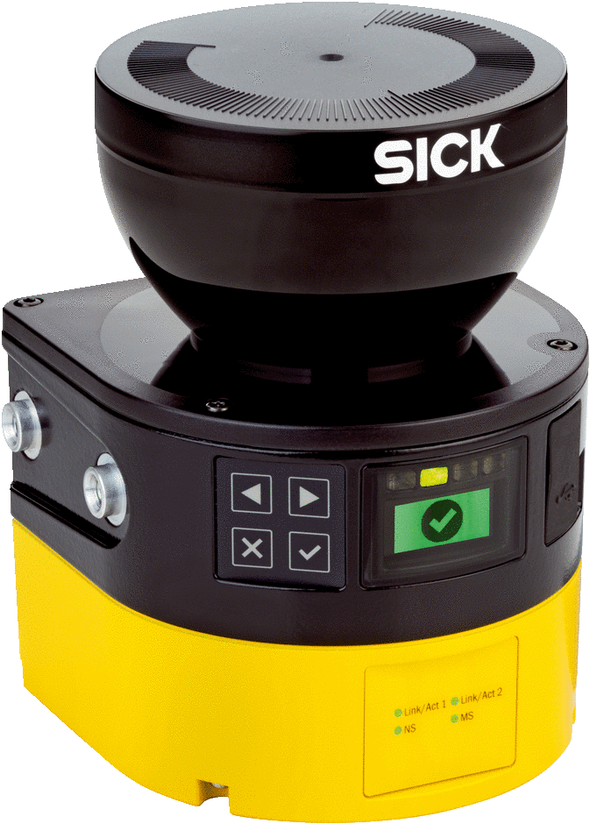
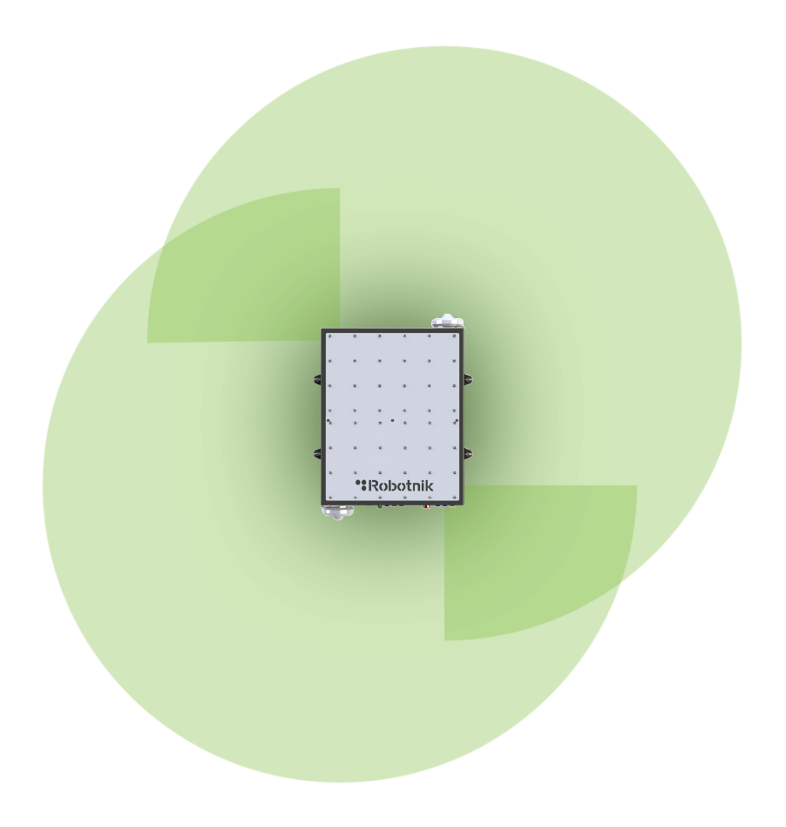
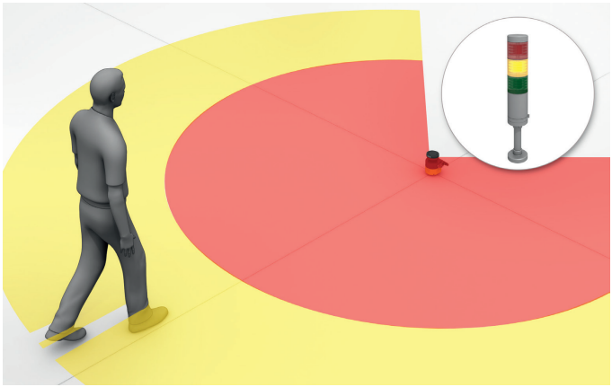
NAVIGATION SYSTEM & CONTROLLER
Safety Laser Scanner - SICK microScan3
275° scanning angle
5.5 m field range

Slide 5
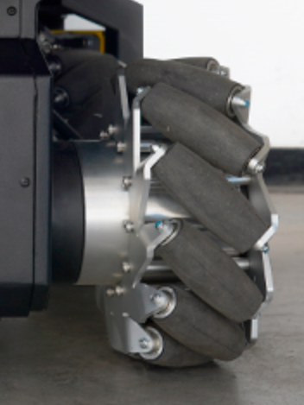
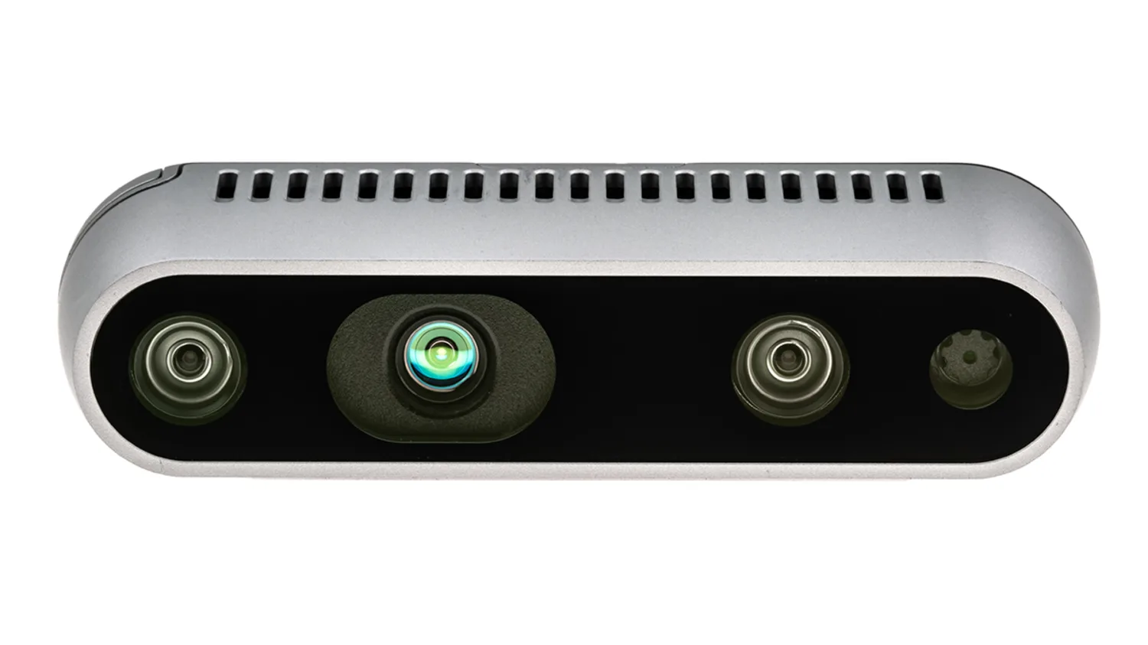
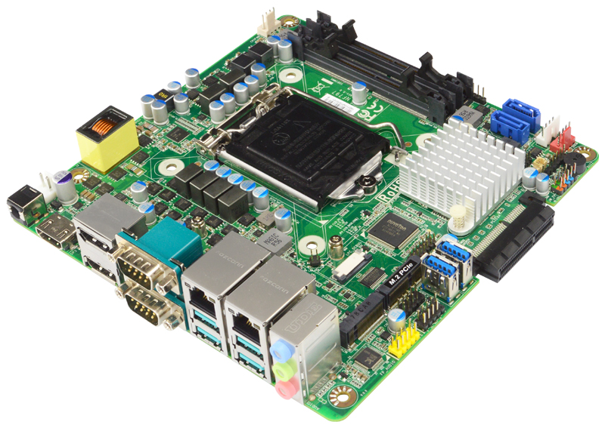
NAVIGATION SYSTEM & CONTROLLER
Wheel Encoders
Built-in
Calculate odometry
Depth Camera - Intel Realsense D435
Closed-range navigation
Dynamic obstacle avoidance
Realtime video for teleoperation
Controller - JNF797-Q370
Embedded PC with Linux
i7, 8th Gen, 8GB RAM, 250GB M.2 SSD
ROS Architecture

Slide 6
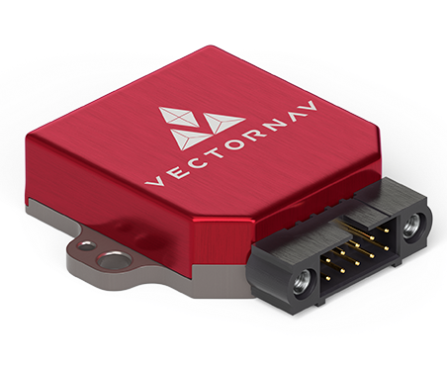
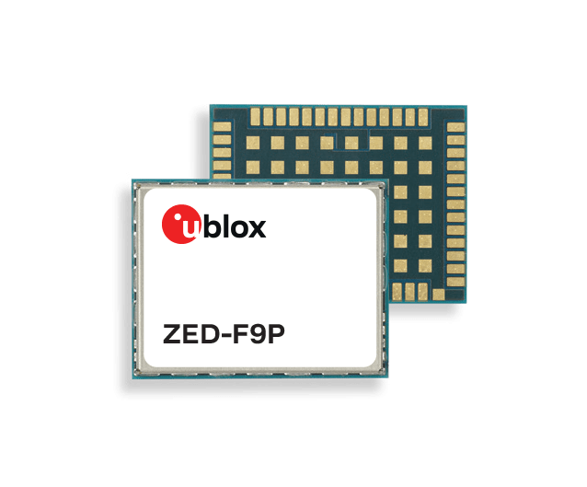
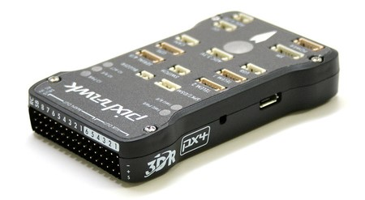
NAVIGATION SYSTEM & CONTROLLER
IMU - Vector Nav VN-100
GPS - ZED-F9P module
IMU - Pixhawk

Slide 7
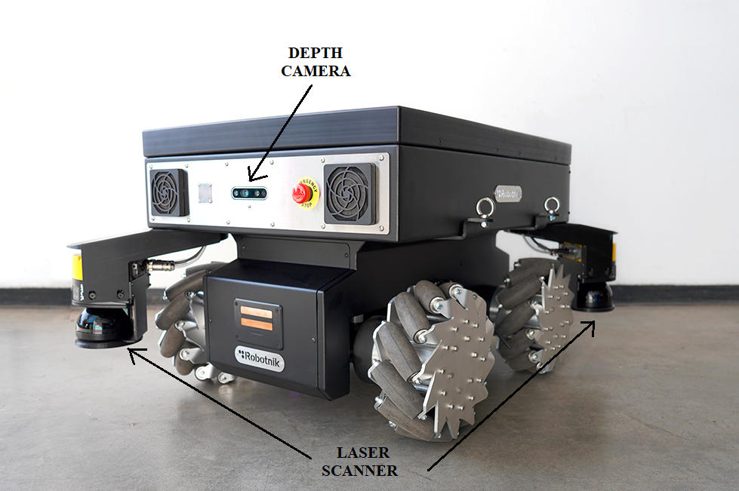
NAVIGATION SYSTEM & CONTROLLER

Slide 8
DATA COLLECTION
Industrial Applications
Logistics
Surveillance & Monitoring
Research & Development

Slide 9
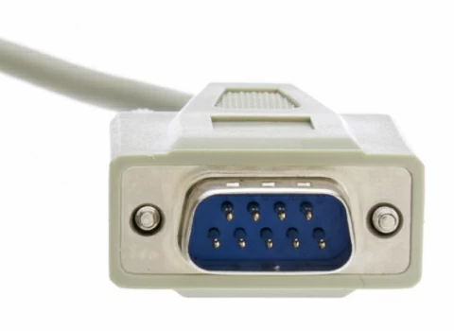
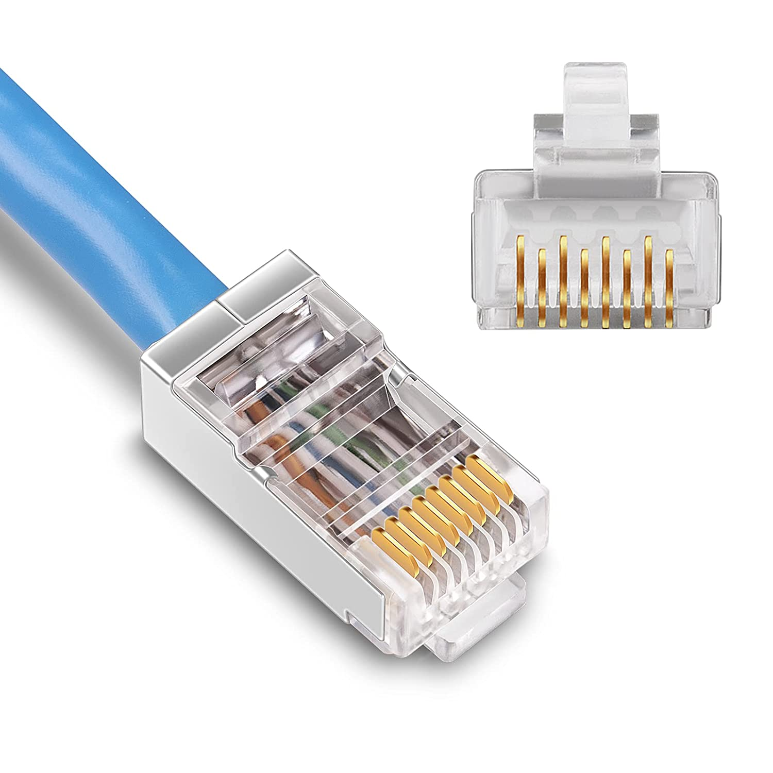


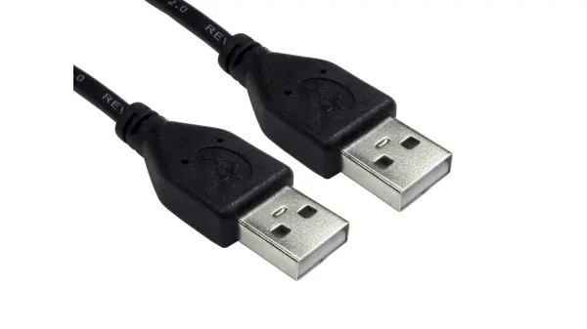
DATA TRANSMISSION
WiFi
802.11 a/b/g/n/ac
RS 232 Serial Communication
Bluetooth 5.1
USB
RJ 45
Communication
Internal Connection
External Connection
Notes:
WiFi and bluetooth to connect with the main system
RS 232 to connect with the LiDar Sensor
USB connect sensors
External connection - to add custom components easily

Slide 10
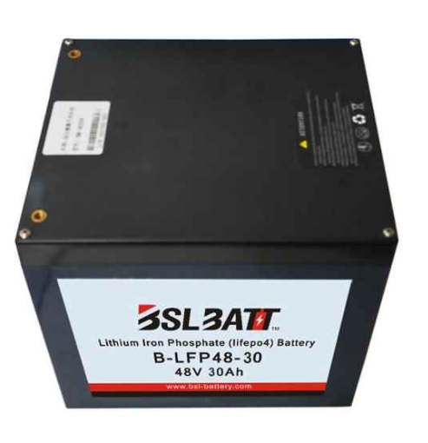
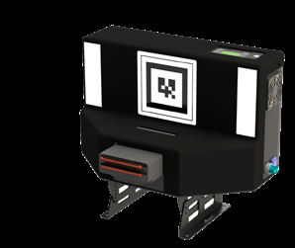
POWER SYSTEM MANAGEMENT
Charging Process
Internal circuitry and a magnetic sensor
Adjustable voltage and can charge up to 800W
1.2 hours full charge (standard battery)
Autocentered feature using AR tag
Docking Station
LiFePO4
15/30 Ah @ 48VDC

